Slide 1
Ban6420 Final project
INCOME SPENDING ANALYSIS
BY: ETIMBUK EDET BASSEY

Slide 2
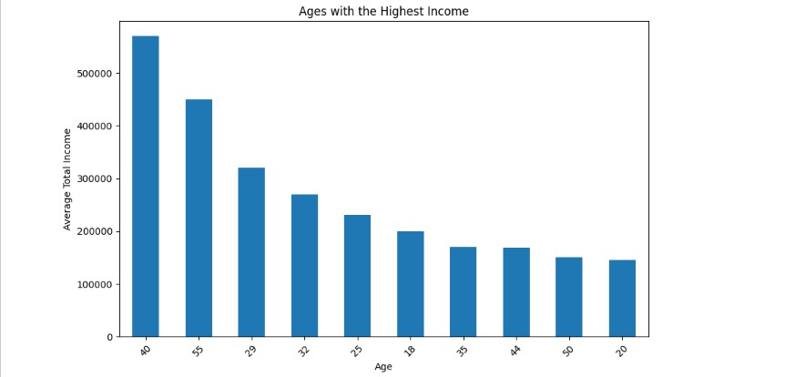
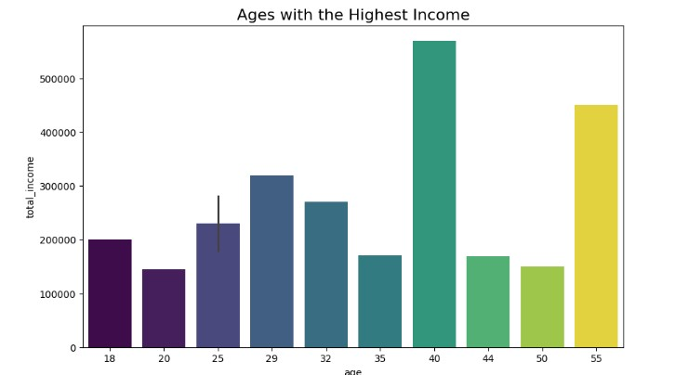
Age-income distribution
Interpretation
The visualizations shows that ages with higher incomes tend to be older and this is a realistic trend , as income levels increases with age due to factors such as career advancement and years of experience.

Slide 3
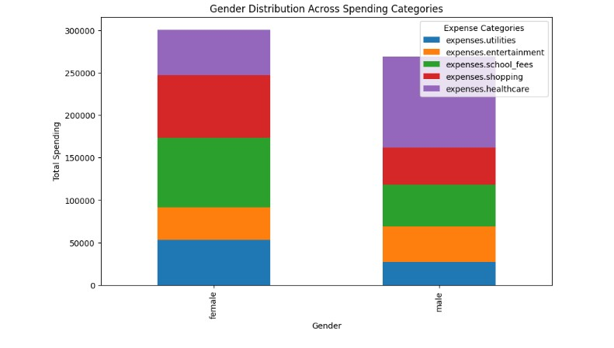
GENDER DISTRIBUTION ACROSS SPENDING CATEGORIES
These clustered chart shows that male gender has the highest expenditure on healthcare, while female has the highest expenses on school fee, and shopping which the primary expenditure surpassing other categories. Conversely, expenditures on entertainment appear notably lower for both genders

Slide 4

THANK YOU

